Slide 1


Day Care System
Created By
Priyanka Chaudhari & Dhanashree Phuge

Slide 2

Introduction
I hereby declare that the present mini project work “Kinder Garten Daycare System” is original work carried out under the guidance of both teachers.
The main objective for developing this web-based application is to provide an easier way to enroll child in a day care. It will use a database and webserver backend and will present an easy-to-use interface for children to be checked in and their information to be managed. In “Kinder Garten Day care System” we use JAVA Springboot and MySQL database. This project have two main modules admin and users and other are sub modules like as babysitter, contactus, payment, services.

Slide 3
Why we choose this project tittle
Kinder garten day care system to solve the problem of children’s parents who want to enroll their child and also reduce the manual work for managing the details. It will use a database and webserver backend and will present an easy to use interface for children to be checked in and their information to be managed.
This application has good appearance and is very easy to operate. It is very simple and easy to access. It saves our time and money. This project provides a lot of features to manage in very well manner. This project contain a lot of module which make the backend system powerful .

Slide 4
Need for System
Day care encourages your little one to explore their environment, interact with their peers, and find their own interests and hobbies. This encourages your little one to develop emotional intelligence and independence. Being independent at an early age builds your child’s self-esteem. In daycare many children are interact to each other they are independent on parents, connection and communication skills are increases .
your child’s autonomy and independence at a young age is essential in setting them up to lead a life as a confident and capable adult. A quality daycare program will provide endless opportunities for children to strength their skills, becoming more autonomous and independent each day
Your child’s opportunity to build positive relationships with their teachers and parents is also significant in their development, as it will support a strong attachment style, which has significant long-term positive implications on their social and emotional well-being .

Slide 5
Requirements Client side
Operating System | Windows 10,11
Processor | I5
RAM | 4 GB
Browser | Microsoft Edge, Google Chrome, etc.

Slide 6
Server side
Operating system | Windows 10,11
Frontend | Html, CSS, JavaScript
IDE | Eclipse, VS code , Postman
Backend | JAVA Springboot, MySQL Database Server
Server | Apache Tomcat

Slide 7
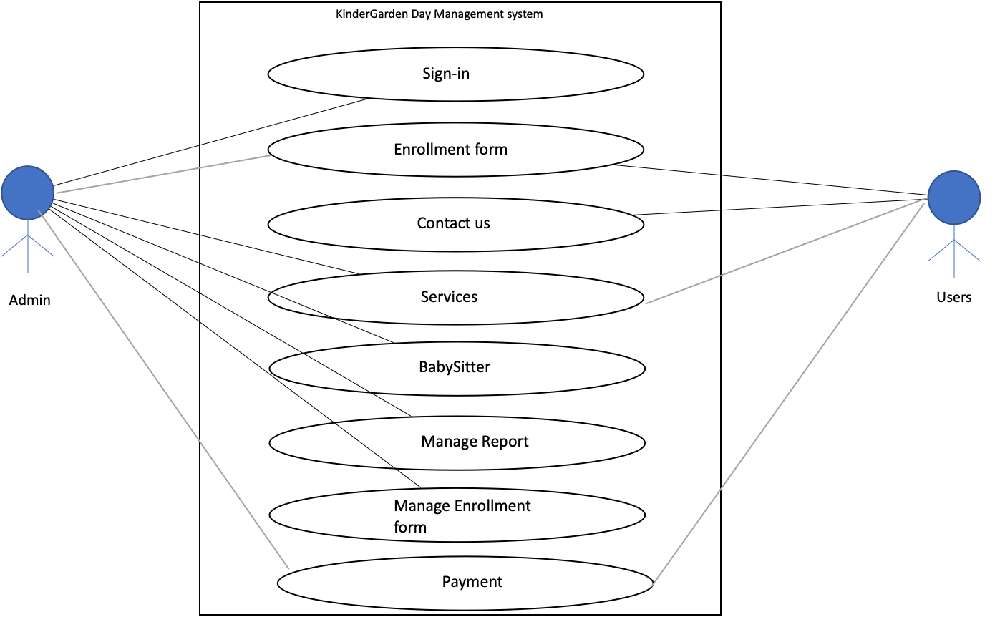
Use case diagram

Slide 8
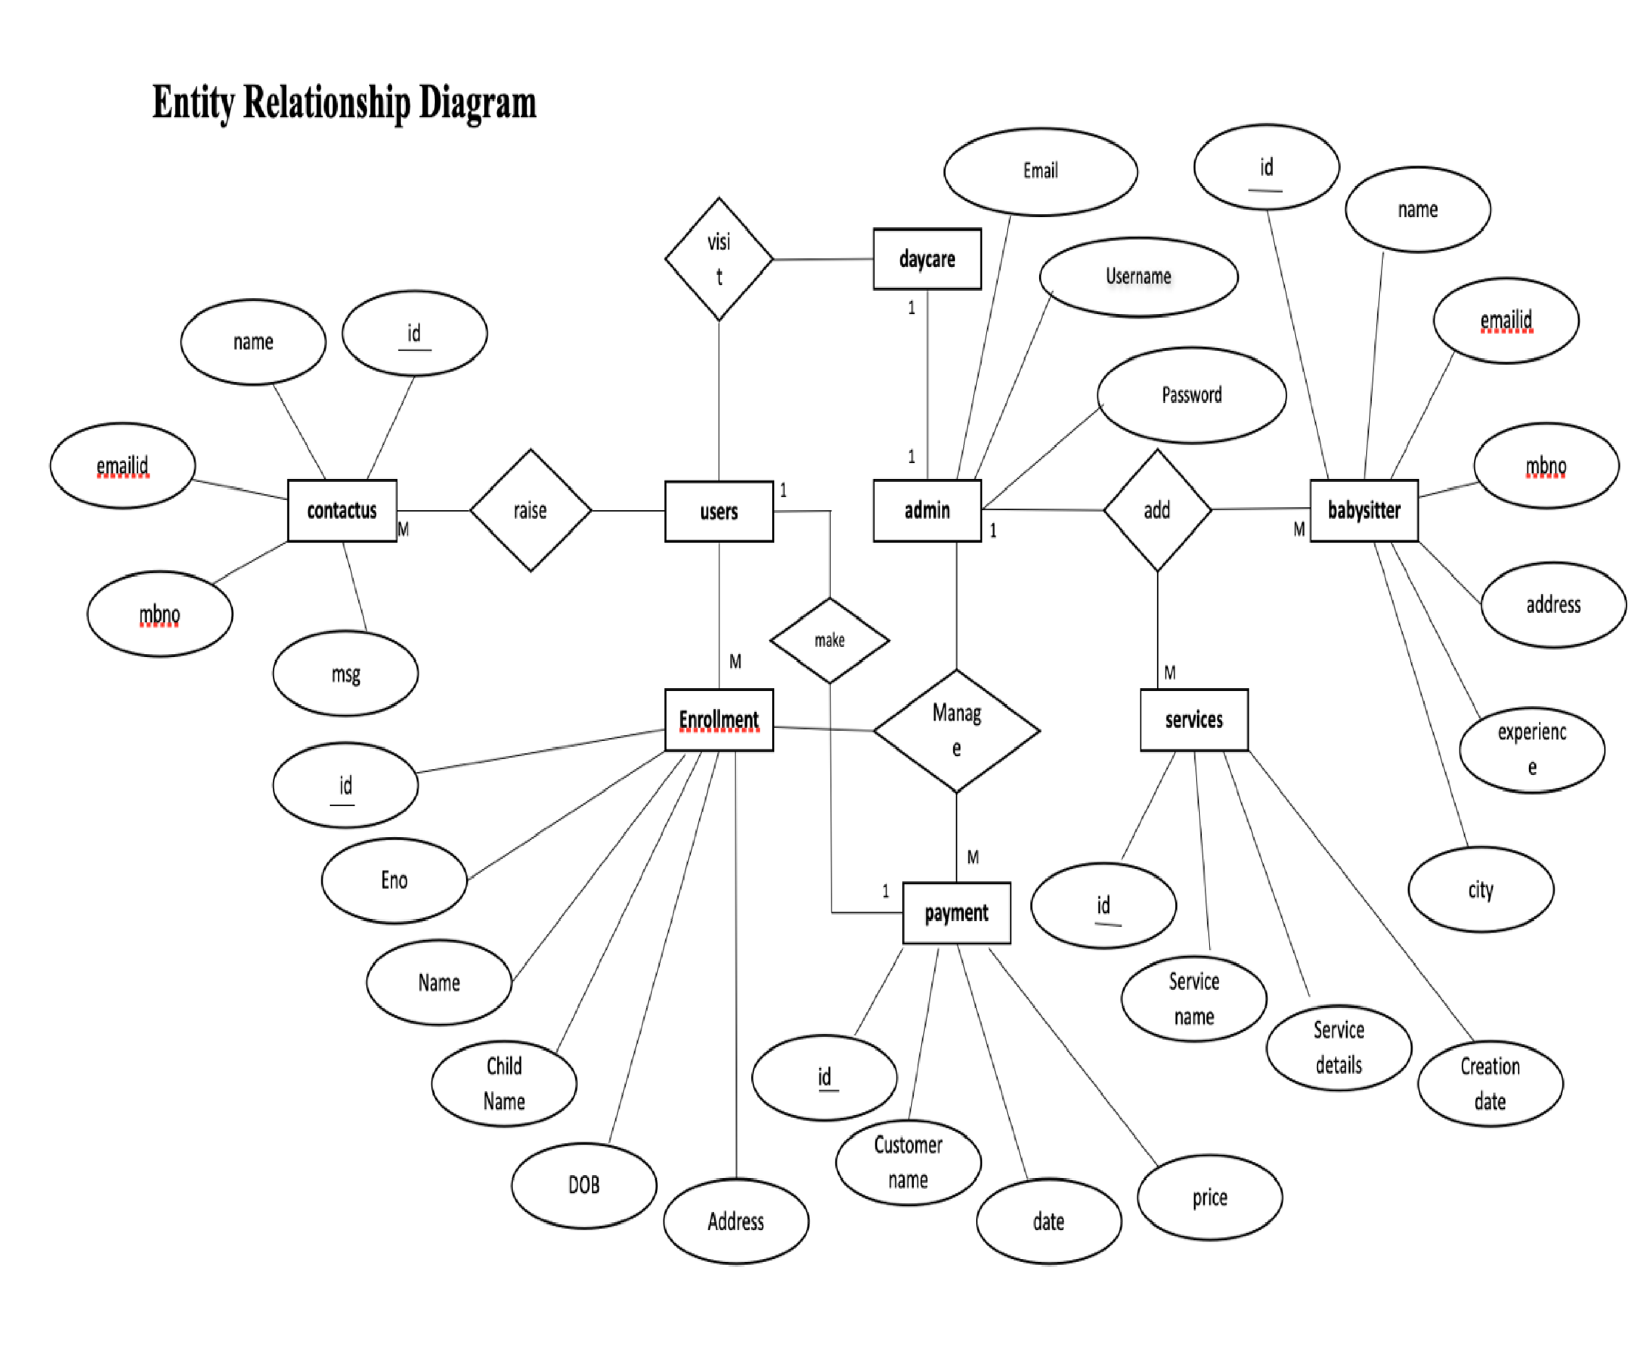

Slide 9


